Slide 1
Tracking
Chapter 9

Slide 2
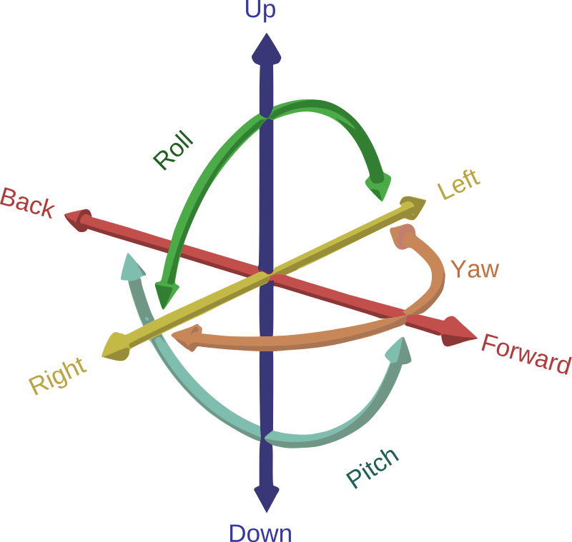
Tracking
The body and component parts have degrees-of-freedom
While the body can translate all the joints are rotation axis’s
In VR applications head tracking has been solved while eye tracking, less so

Slide 3

Tracking Error
Let $\hat{ω}$ be the mesured value of some ω
$\hat{ω}$= a + bω
$\hat{ω}$− ω = a + bω − ω = a + ω(b − 1)
Error vs actual Difference
d(t) = ($\hat{ω}$ − ω)t= (a + bω − ω)t= (a + ω(b − 1))t

Slide 4
Error reduction Solutions
Calibration – using a known state or a better sensor to correct
Integration – samples at intervals lets aggregation with other sensors
Registration – smart default values or initialization process
Drift error – fixed using sensors to detect error and compensate for

Slide 5
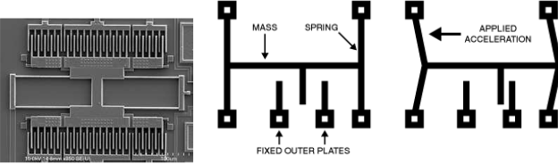
Sensors
Inertial Measurement Unit – once a heavy machine now available as a microscopic chip with 3 axis rotation sensors - they vibrate like a tuning fork and produce an electrical current if force is applied in its axis of sensitivity

Slide 6
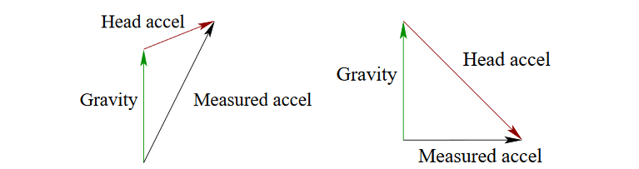
Direction correction and gravity
Finding Up if the sensor isn’t moving up is the opposite of the acceleration due to gravity
Issue is gravity is indistinguishable from normal acceleration In practice only trust the accelerometer if the value is 9.8m/s²

Slide 7
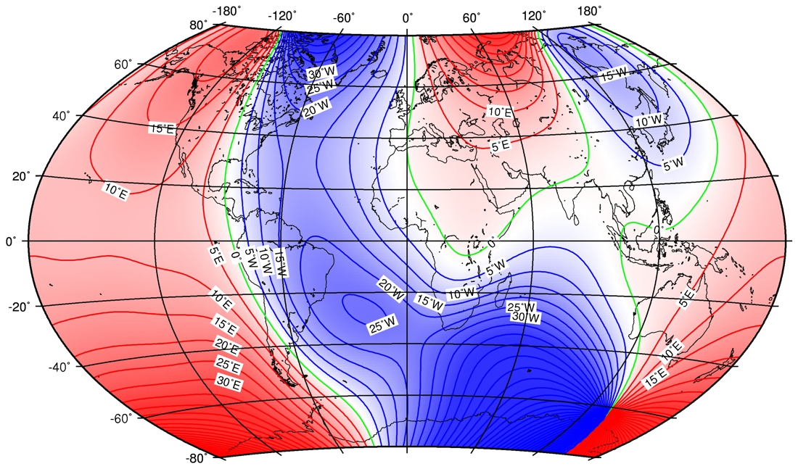
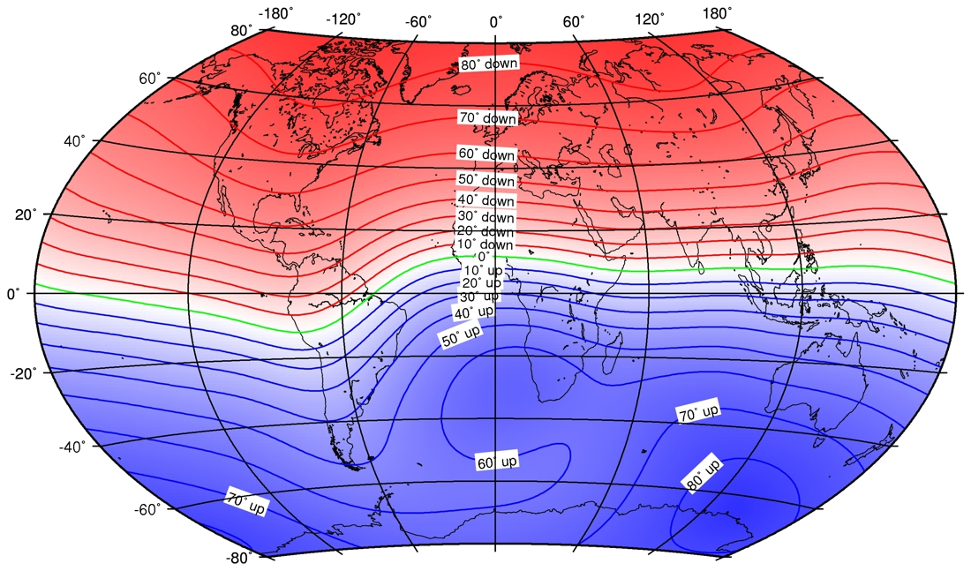
Direction correction and magnetic fields
If location isn’t changing local magnetic fields are relatively constant.
Large metal buildings and other ferromagnetic material will influence the magnetic field as it is a sum of all induced fields

Slide 8
Point Tracking
Natural Feature – objects in the environment that can be detected
Tables, faces, walls
Artificial Feature – objects that are engineered to be detected
QR codes, IR reflectors

Slide 9
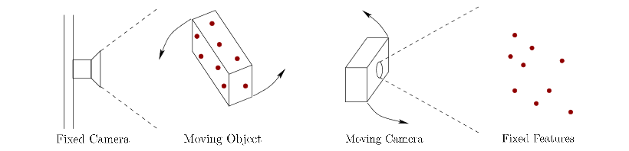
The Perspective-n-Point problem
A camera has 6 Degrees of freedom
Each point visible can account for 2 degrees of freedom

Slide 10
Eye tracking
electro-oculography – puts electrodes on the muscles around the eye
Electromagnetic contact lenses
Video oculography – shine inferred into the eye and measures the refraction

Slide 11
Tracking Attached bodies
Forward Kinematics – the summation of eye and head tracking using the size and transform of each component the entire object can be correctly determined in space
Inverse Kinematics – using the known end point to transform the other axis’ ambiguous positions can happen.

Slide 12
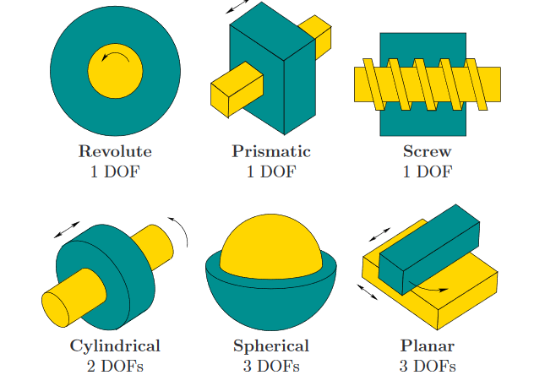

Slide 13
3D scanning
Stereo cameras get position and depth information
Panoramic stitching can be used to get full 360 scan

